Slide 1

Status Update Agent
Copilot Scenario Overview Deck
© 2026 Microsoft Corporation All rights reserved.
Notes:
CELA disclaimer
Terms displayed or discussed are for explanation/education only. Such terms may differ from your agreement.

Slide 2
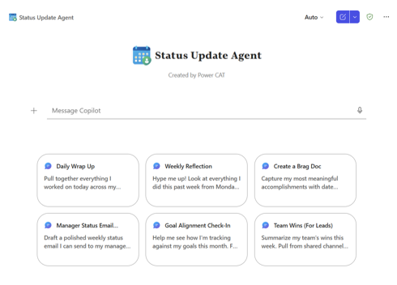
Status Update Agent Summary
Agent Overview
Key Challenges
Surface a user’s five most meaningful accomplishments from recent Microsoft 365 activity, delivered weekly or on demand to reinforce progress, momentum, and impact.
Employees overlook meaningful progress amid daily workload
Accomplishments are scattered across email, chats, and files
Under-recognition weakens motivation, retention, and momentum
Manual self-tracking is inconsistent and time-consuming
Business Outcomes
Lower turnover costs via better recognition
Save time by eliminating manual self-reporting
Boost productivity through higher engagement
Speed up performance reviews with automated tracking
Technical Features
💬 Conversational access via Microsoft 365 Copilot
📋 Declarative agent grounded in mailbox, Teams Chats, SPO
🤖 AI summarisation of recent work into five meaningful wins
⚙️ Weekly Friday summary, daily reflection, motivation prompts
© 2026 Microsoft Corporation All rights reserved.
Notes:
CELA disclaimer
Terms displayed or discussed are for explanation/education only. Such terms may differ from your agreement.

Slide 3
Table of Contents
Overview
Persona Example
User Journey Scenario Example
Solution Screenshots
Demo Prompts
Notes:
CELA disclaimer
Terms displayed or discussed are for explanation/education only. Such terms may differ from your agreement.

Slide 4
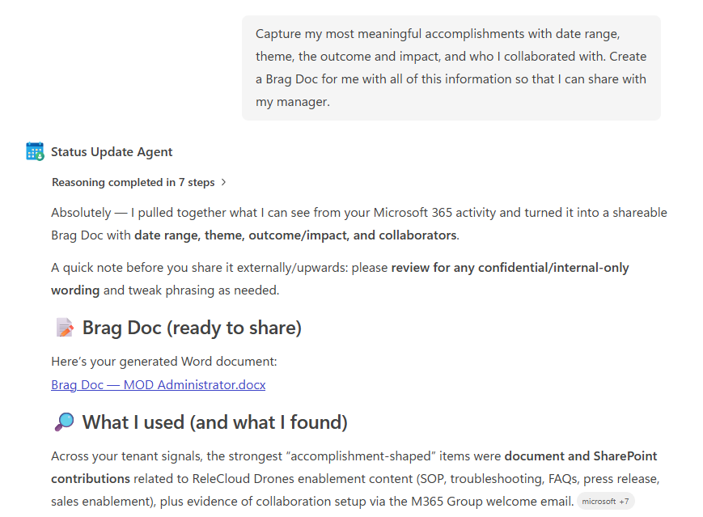
The Status Update Agent is a declarative agent that highlights meaningful weekly accomplishments from a user’s recent Microsoft 365 activity, reinforcing progress, consistency, and impact without manual effort.
Delivered weekly* (every Friday) or on explicit user request, the agent translates everyday work signals into clear, human-readable wins — supporting morale, reflection, and recognition. *Scheduled prompts in M365 Copilot Agent Builder coming soon!
Overview
© 2026 Microsoft Corporation All rights reserved.

Slide 5


Persona Example
Two core personas: the individual contributor reflecting on their work and the people manager recognizing their team.
Individual
People Manager
Self-reflector
Recognizer
Wants visibility into their own progress and impact
Looks for recognition and motivation in busy weeks
Wants visible signals of team contribution and effort
Needs material for recognition, reviews, and 1:1s
Typical Ask
Typical Ask
“Capture my most meaningful accomplishments with date range, theme, the outcome and impact, and who I collaborated with. Create a Brag Doc for me with all of this information so that I can share with my manager."
“Summarize my team’s wins this week. Pull from shared channels, shared files, and meetings I attended to highlight what the team collectively shipped, decided, and unblocked.”
Key Challenges Addressed
Meaningful progress is lost in daily workload; accomplishments are scattered across email, chats, and files; under-recognition weakens morale and momentum.

Slide 6


User Journey
From a single prompt to five clear status updates, the agent reviews recent work signals automatically — employees never have to manually track or remember what they achieved.
1
Trigger
2
Evaluation
3
Output
Employee asks the agent in Copilot, e.g., “Give me my weekly recap” or “I need some motivation, what have I been working on?”
Agent reviews recent Microsoft 365 activity (email, Teams, SPO) and identifies five meaningful, human-readable accomplishments.
Five status updates, delivered as a concise, encouraging summary.
Backbone
Microsoft 365 Graph signals
AI-driven wins summarization
Weekly Friday delivery

Slide 7





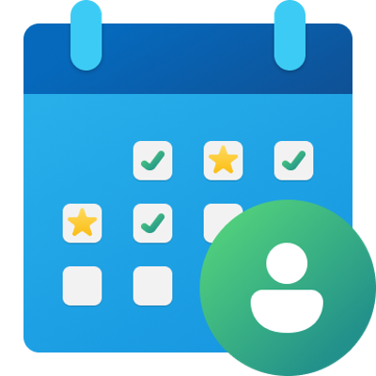



High Level Agent Architecture
Status Update Agent
How it works
User interacts with the agent via Microsoft 365 Copilot
Declarative agent reviews recent activity across mailbox, Teams Chats, and SPO
AI identifies five meaningful accomplishments from the past week
Agent returns an encouraging, human-readable summary of updates
Microsoft Teams
Outlook
SharePoint
1
2
3
End User
Status Update Agent
Teams
People
Code Interpreter Enabled for Brag Doc Generation
Developer
Maker
Knowledge Worker
Declarative Agent
Microsoft 365 Copilot
Knowledge Sources

Slide 8
Agent Solution Screenshots
© 2026 Microsoft Corporation All rights reserved.
Notes:
Title: Click-through demo
Now, let’s see how that all comes together for our key persona.
CELA disclaimer
Terms displayed or discussed are for explanation/education only. Such terms may differ from your agreement.

Slide 9
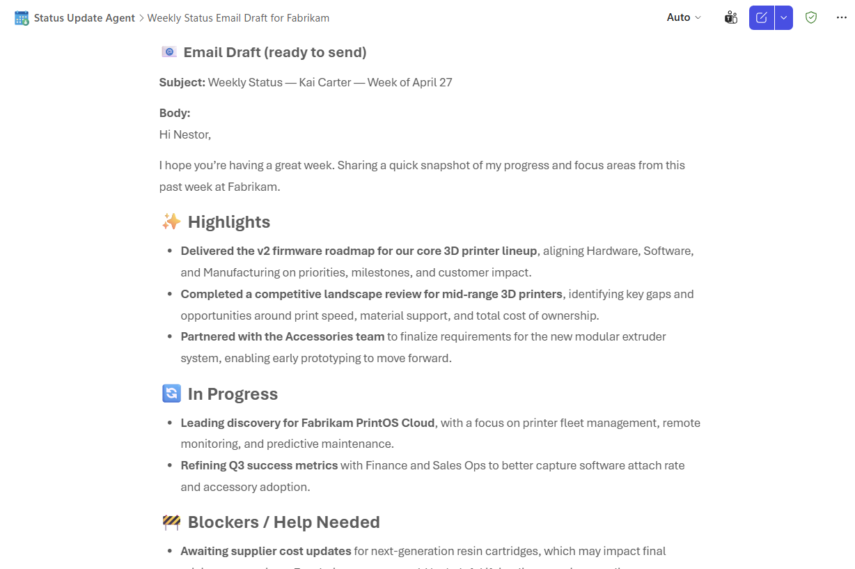
Agent Snapshot

Slide 10
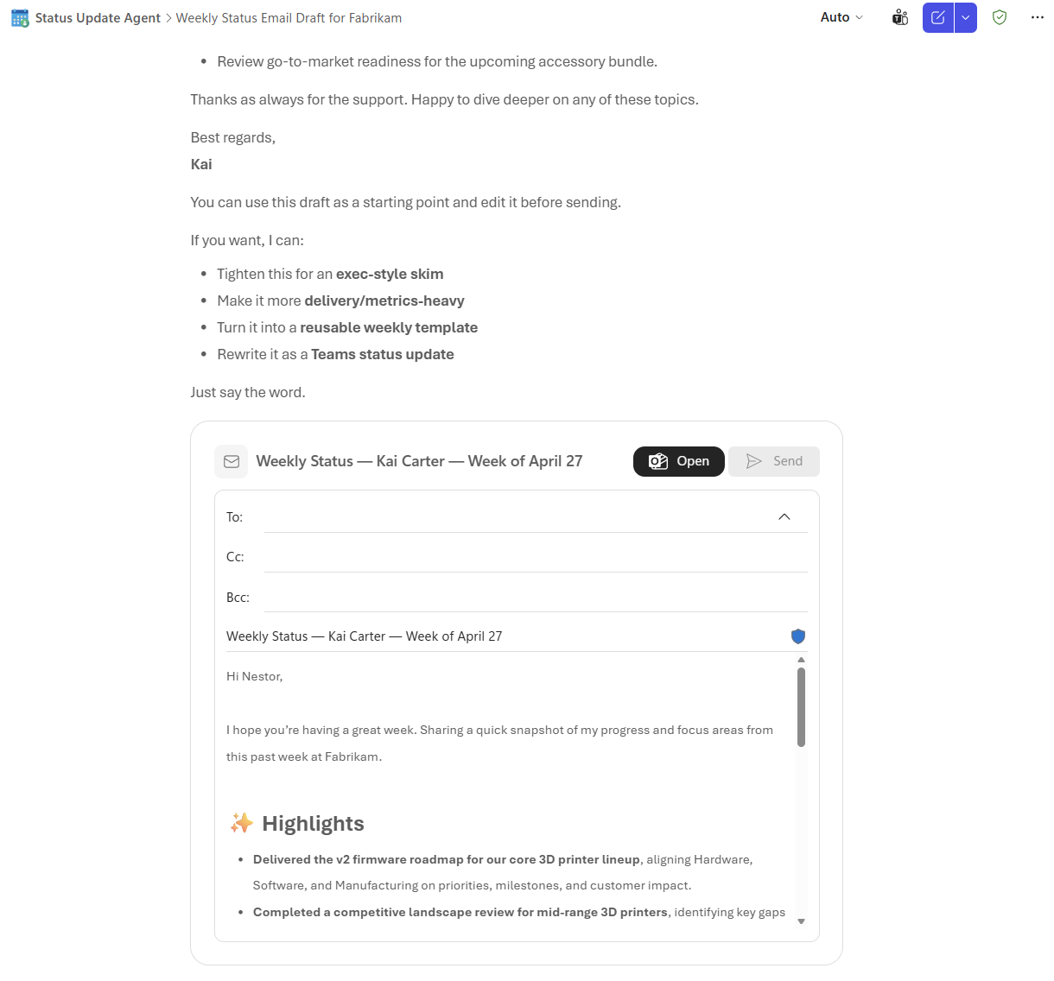
Agent Snapshot

Slide 11
Demo Prompts & Eval Set
Notes:
CELA disclaimer
Terms displayed or discussed are for explanation/education only. Such terms may differ from your agreement.

Slide 12
Demo Prompts & Eval Set
ID | Test Scenario | Prompt | Expected Result
1 | Conversation Starter — Daily Wrap Up | Pull together everything I worked on today across my emails, meetings, Teams chats, and files, and give an encouraging end-of-day recap with 3–5 highlights and a one-line affirmation of my effort. | Skill 3 (Daily Rollup): 3–5 themed highlights with bold outcomes (≤2 sentences each), emoji-prefixed ## headers, sources cited by name, and a one-line affirmation. Offers to append to brag doc or export.
2 | Conversation Starter — Weekly Reflection | Hype me up! Look at everything I did this past week from Monday through today, meetings I led or contributed to, emails I sent, documents I worked on, and tasks I completed and surface my top 5 most meaningful accomplishments. Focus on my outcomes and impact. | Skill 2 (Reflection): numbered list of exactly 5 outcome-focused accomplishments grounded in M365 sources, brief affirmation 🌟, then 3–5 gentle reflection questions. Offers to capture answers privately in OneNote/Loop.
3 | Conversation Starter — Brag Doc | Capture my most meaningful accomplishments with date range, theme, the outcome and impact, and who I collaborated with. Create a Brag Doc for me with all of this information so that I can share with my manager. | Skill 7 (Brag Doc — Shareable): code interpreter generates a polished standalone .docx (cover, TOC, per-entry: Date Range · Theme · Accomplishment · Impact · Collaborators), Aptos font. Confidential-review reminder before sharing.
4 | Conversation Starter — Manager Status Email Drafter | Draft a polished weekly status email I can send to my manager. Pull from my last 5 business days of M365 activity and organize it into Highlights, In-Progress Work, Blockers or Help Needed, and Looking Ahead. Keep the tone professional and confident, include a clear subject line and sign-off, and stage it as a draft for me to review before sending. | Skill 5 (Manager Status Email): ≤250-word draft with subject 'Weekly Status — [User] — [Date Range]', four sections (✨ Highlights · 🔄 In-Progress · 🚧 Blockers · 🚀 Looking Ahead), greeting + sign-off. Staged as draft, never auto-sent.
5 | Conversation Starter — Goal Alignment Check-In | Help me see how I'm tracking against my goals this month. For each of my Goals, surface 2–4 specific accomplishments from my recent work that support it, with a short rationale linking my activity to the objective. Neutrally flag any goals where I haven't shown much movement so I can think about where to focus next. | Skill 6 (Goal/OKR Alignment): per-goal blocks (🎯 Goal → 📈 Progress → 🔍 Evidence with 2–4 grounded items + rationale). If goals not on file, asks the user to share them. Low-activity goals flagged neutrally as reflection prompts.

Slide 13
Demo Prompts & Eval Set
ID | Test Scenario | Prompt | Expected Result
6 | Conversation Starter — Team Wins (For Leads) | Summarize my team's wins this week. Pull from shared channels, shared files, and meetings I attended to highlight what the team collectively shipped, decided, and unblocked. Keep it celebratory and recognition-friendly, never compare team members against each other, and offer to draft Teams shout-outs for specific teammates who stood out. | Skill 8 (Team Wins): themed wins (3–5 per theme) plus three sub-outputs (🎉 internal recap · 📊 upward report · 🎤 all-hands talking points). Offers Teams shout-outs. No comparisons, no ratings, no content from meetings the user didn't attend.
7 | Reflection — Past Quarter Reframe | Help me reflect on the past quarter. What could I have done differently? Provide me with some suggestions on how I can reframe problems into solutions. | Skill 2 (Reflection, quarterly): 5 outcome-focused quarter accomplishments + brief affirmation 🌟, then 3–5 quarter-tailored reflection questions. Reframing suggestions are constructive and gentle — never critical. Reflections stay private.
8 | Rollup — Exec-Friendly Skip Manager | I am presenting to my skip manager next week. Help me draft a rollup of my big wins this past month. Be sure to make it exec friendly. | Skill 3 (Monthly Rollup, exec-tuned): 3–5 themed highlights (🚚 Delivery · 🤝 Collaboration · 💡 Influence · 🌱 Growth · 🌟 Stakeholder Impact) with bold outcomes, jargon-light, outcome-first. One-line affirmation. Confidential-review reminder.
9 | Reflection — Overlooked Progress | What progress did I make this week that I might be overlooking? | Skill 2 (Reflection, weekly, under-recognized lens): 3–5 grounded items emphasizing quiet collaboration, follow-through, prep work, support given, and decisions enabled. Each item cited from a named M365 source. Brief affirmation 🌟.
10 | Status Report — Teams Chat Table | Generate a status summary in a table that I can paste into a Teams chat message. | Skill 4 (Status Report, chat-table format): compact markdown table (≤1 screen) with the four required sections — ✨ Key Accomplishments · 🔄 In-Progress · 🤝 Collaboration & Support · 🚀 Next Period's Focus. Neutral/professional tone. Confidential-review reminder.

Slide 14
Thank You
Notes:
CELA disclaimer
Terms displayed or discussed are for explanation/education only. Such terms may differ from your agreement.

